Slide 1
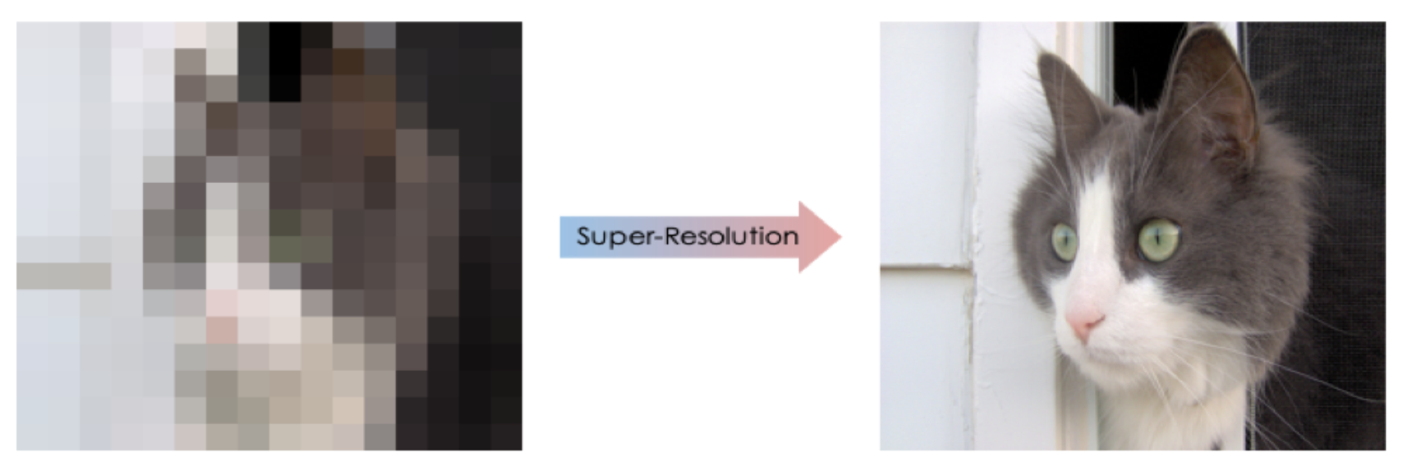
IMAGE SUPER RESOLUTION
Computer Vision and Perception
Presented By:
Tulsi Kumar
Gautam Malik

Slide 2
WHAT IS IMAGE SUPER RESOLUTION?
Image Super Resolution is the process of converting low resolution images to high resolution images.
This techniques is widely used in multiples fields such as
Medical: For improving X-Ray, Tumor, MRI Images
Security: For Surveillance, detecting criminal activity.
Astronomical Imaging: Deblurring the astronomical and space captured images.

Slide 3
DATASET
For this task we are using BSDS500 (The Berkeley Segmentation Dataset and Benchmark) dataset.
The dataset consists of 200 training images and 100 validation images.
For testing purpose, we are using Set5 dataset consisting of 5 images. This dataset is commonly used for testing the performance of our super resolution tasks.
Baby
Bird
Butterfly
Head
Women

Slide 4
Our Approach
Read the images
Preprocess the images
Convert the images to low resolution
Feeding it to the model for training
Testing it on the test dataset.
Evaluating the results.

Slide 5
Data Reading and Preprocessing
In this task of image super resolution, we are reading the images using open cv library.
Resize those images to 240x240 size.
Convert the images to gray scale.
Normalize the images.
Convert the high-resolution images to low resolution by down scaling the images by 2x and 4x factors and using cv2 interpolation methods.

Slide 6
Interpolation Techniques
Different interpolation algorithms include the nearest neighbor, bilinear, bicubic, and others
Interpolation algorithms are predominantly used for resizing and distorting a high-resolution image to an occasional resolution image.
In this task we have used the following interpolation methods to distort the resolution of our images.
Inter Area Inter Cubic
Inter Nearest Inter Linear

Slide 7
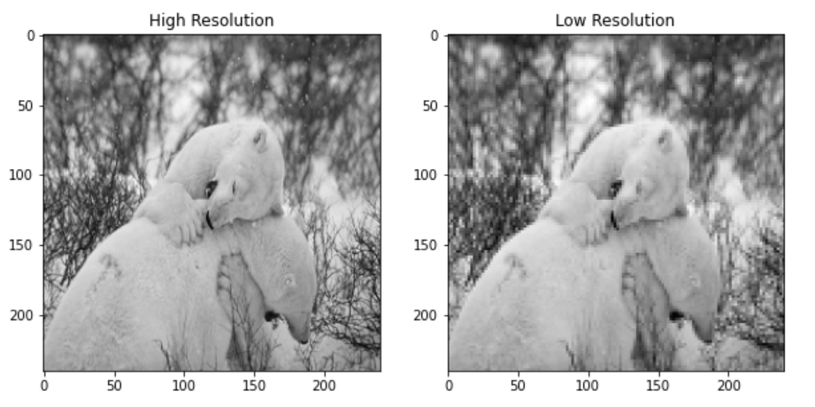
High To low Resolution

Slide 8
Our Model
We use the autoencoder model for training and validation purposes. We train our low-resolution images using the autoencoder model.
Autoencoders like the denoising autoencoder can be used for performing efficient and highly accurate image denoising.
Unlike traditional methods of denoising, autoencoders do not search for noise, they extract the image from the noisy data that has been fed to them via learning a representation of it. The representation is then decompressed to form a noise-free image.
Denoising autoencoders thus can denoise complex images that cannot be denoised via traditional methods.

Slide 9
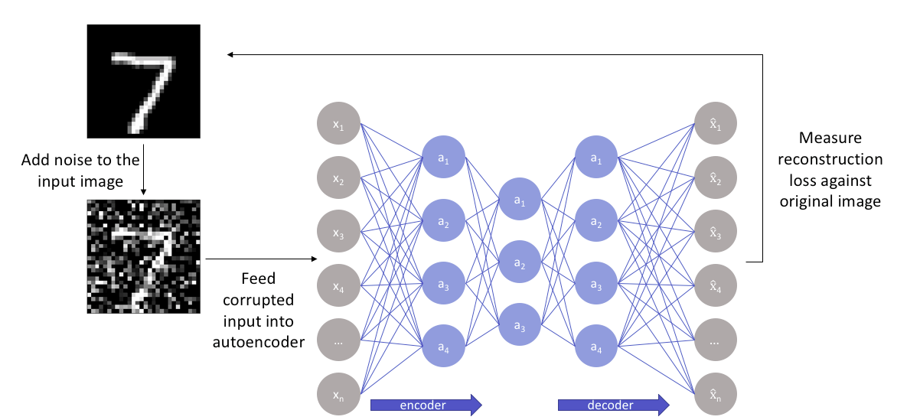
AUTOENCODER MODEL FOR DENOISING

Slide 10
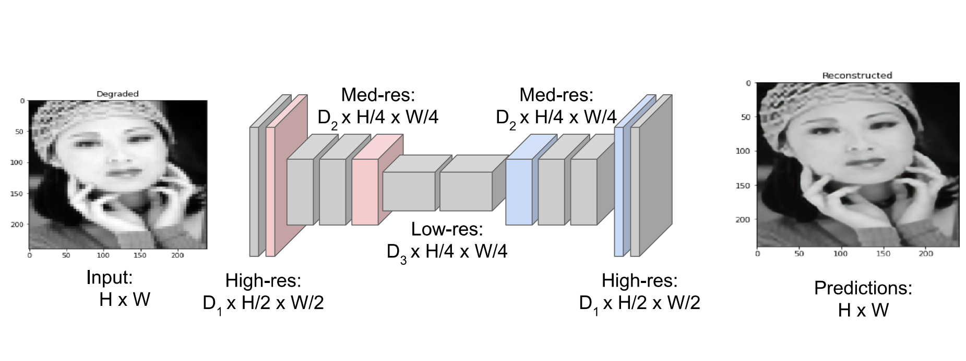

Slide 11
Model Architecture
Encoder Architecture
For the encoder framework we use five Conv2D layers and 2 Max Pooling layers.
Decoding Architecture
2 Up sampling Layers.
5 Conv2D Layers
Other Parameters
Activation function: Relu
Kernel Initializer: Glorot Uniform

Slide 12
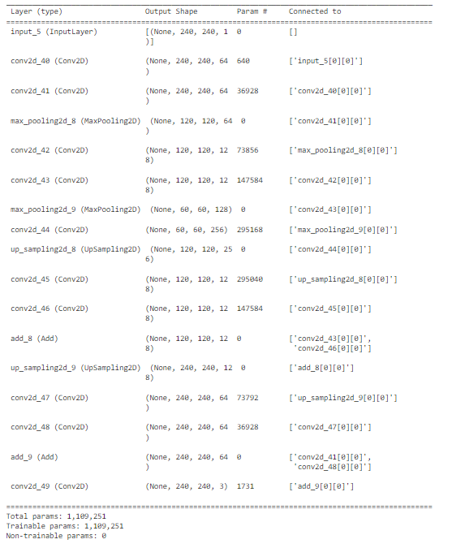
Auto-Encoder Model

Slide 13
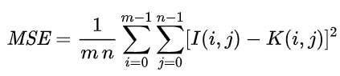
Loss Function: Mean-square error (MSE)
MSE measures the average squared difference between the estimated values (predicted values) and the actual value (ground truth). So we just calculate squared differences pixel by pixel.

Slide 14
Optimizer : Adam
Adam optimization is a stochastic gradient descent method that is based on adaptive estimation of first-order and second-order moments.
Adam is the best among the adaptive optimizers in most of the cases. Good with sparse data: the adaptive learning rate is perfect for this type of datasets.

Slide 15
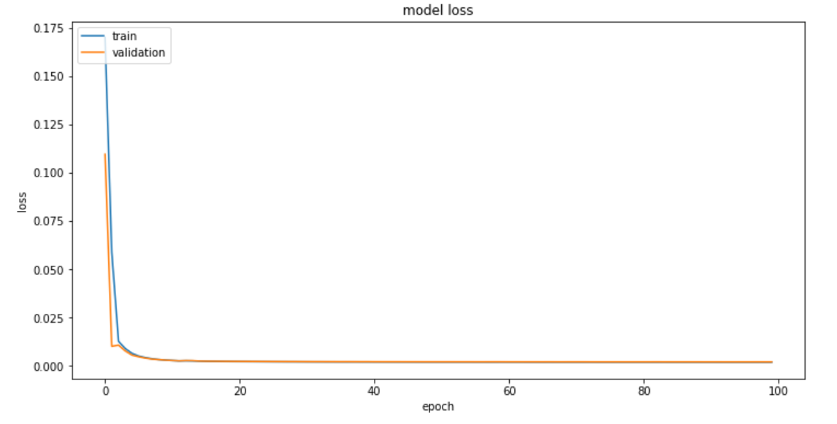
Training and Validation Loss Graph

Slide 16
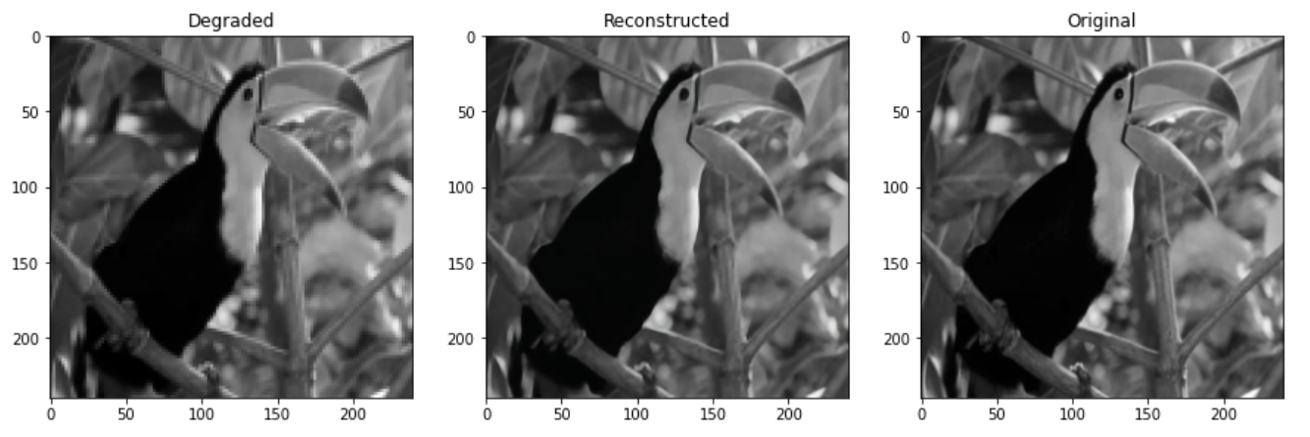
Results 1/8 Interpolation: Inter Area Scale: 2

Slide 17
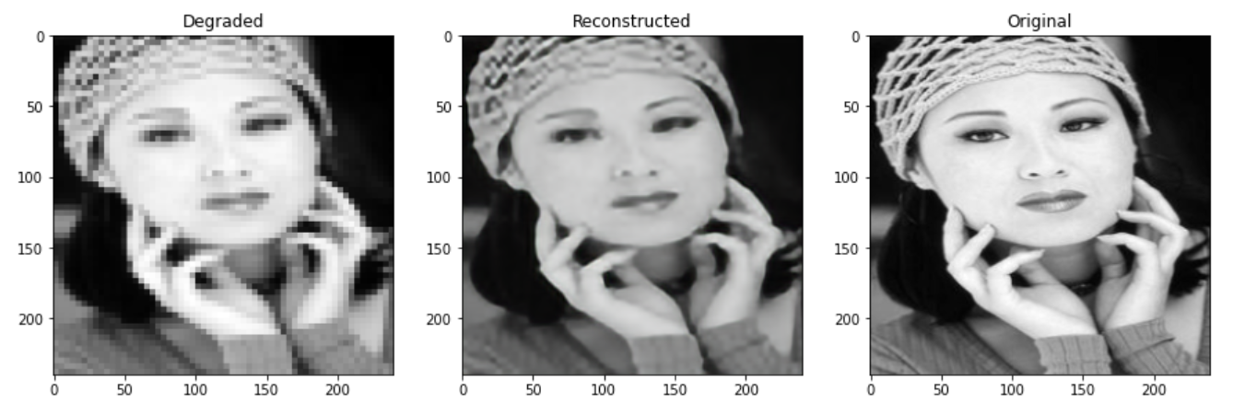
Results 2/8 Interpolation: Inter Area Scale: 4

Slide 18
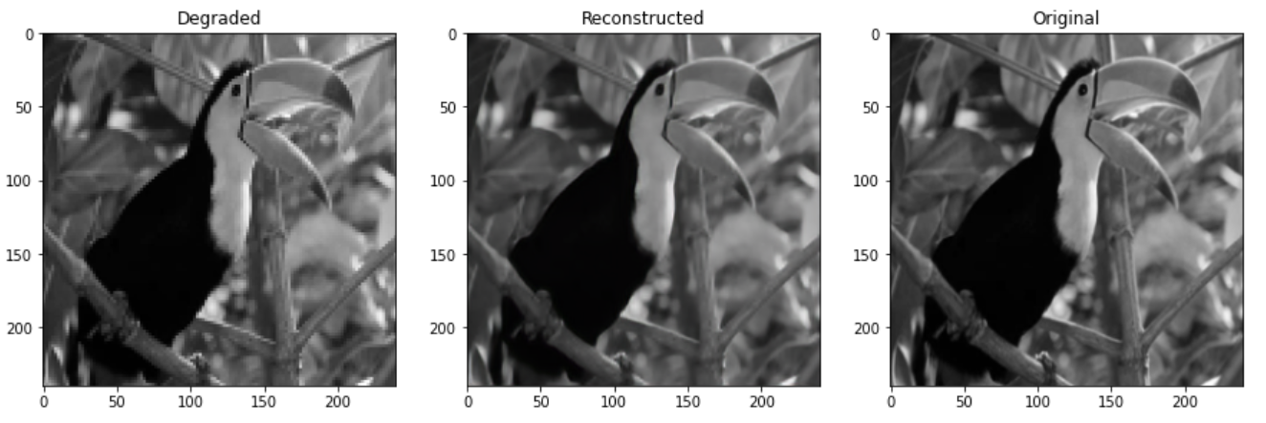
Results 3/8 Interpolation: Inter Nearest Scale: 2

Slide 19
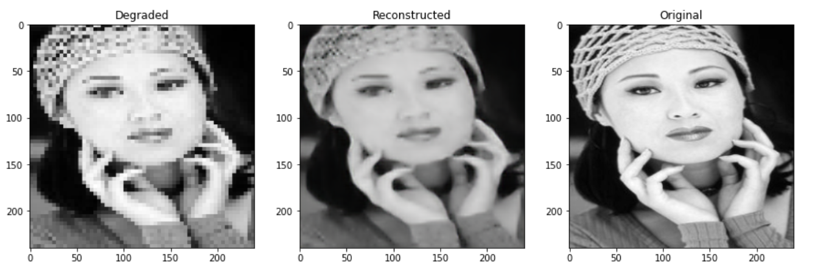
Results 4/8 Interpolation: Inter Nearest Scale: 4

Slide 20
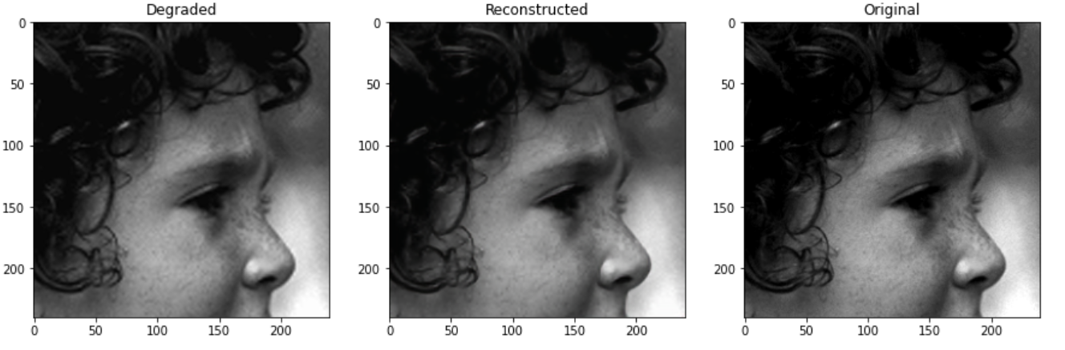
Results 5/8 Interpolation: Inter Cubic Scale: 2

Slide 21
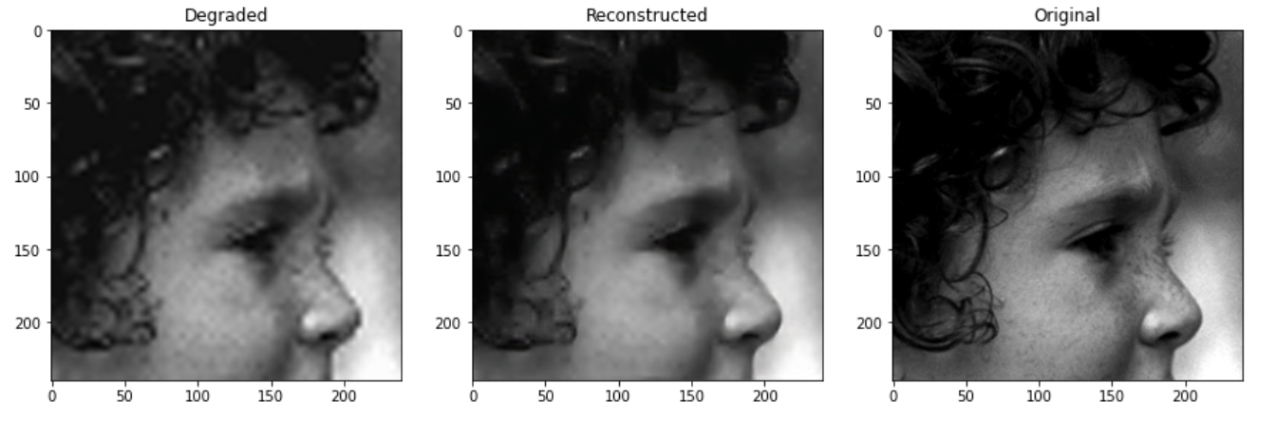
Results 6/8 Interpolation: Inter Cubic Scale: 4

Slide 22
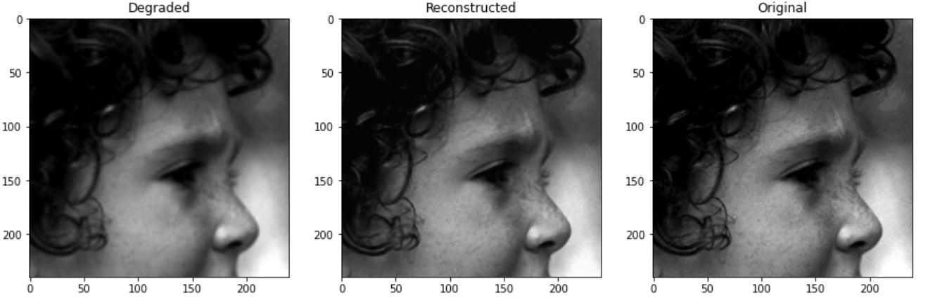
Results 7/8 Interpolation: Inter Linear Scale: 2

Slide 23
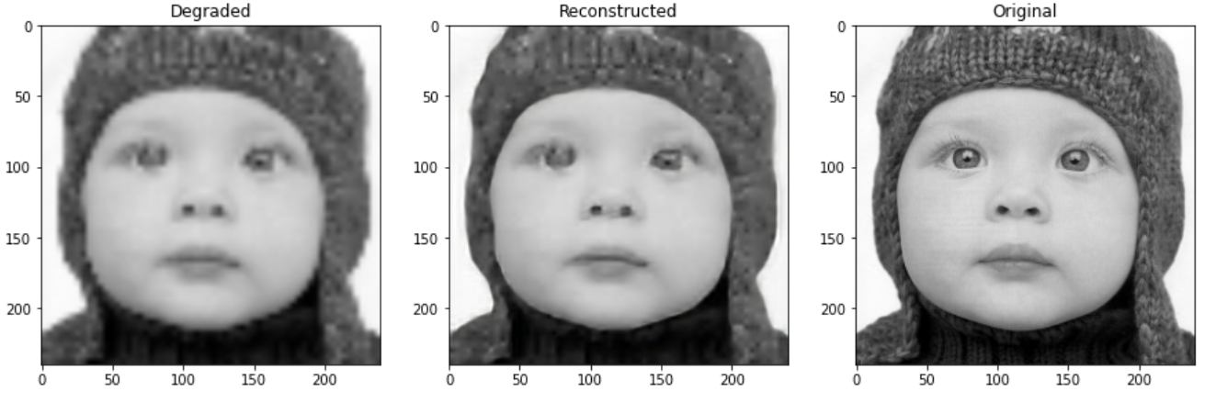
Results 8/8 Interpolation: Inter Linear Scale: 4

Slide 24
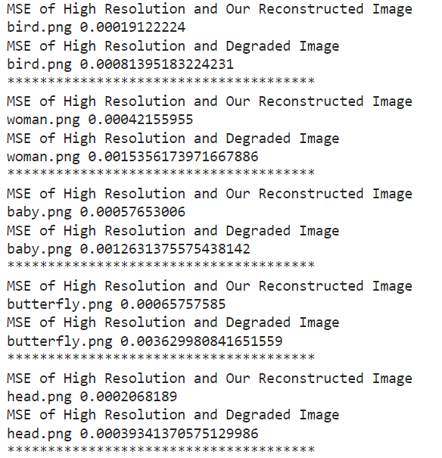
Mean Square Error

Slide 25
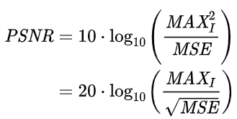
PNSR
The PSNR block computes the peak signal-to-noise ratio, in decibels, between two images. This ratio is used as a quality measurement between the original and a compressed image. The higher the PSNR, the better the quality of the compressed, or reconstructed image

Slide 26
Improved PSNR

Slide 27
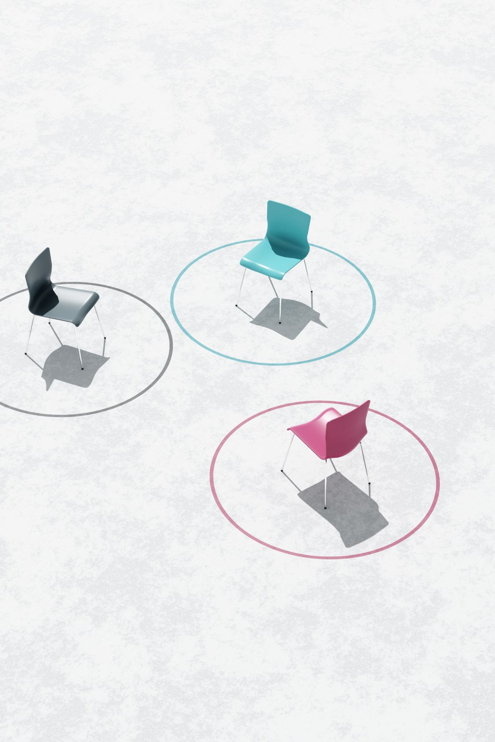
Conclusion
Image super resolution is challenging but an interesting task. We tried the image super resolution by degrading the image with multiple interpolation methods and then reconstructing the image using our denoising autoencoder model.
The results were quite significant as the shown in the comparison tables with increase in PNSR score of reconstructed images and decrease in their mean squared error.

Slide 28
Future Work
The model can be improved using large size of dataset with different type of images.
For the loss calculation Mean Square is used which is pixel to pixel improvement. We can take patches and improve them collectively using different loss function.
A pre-trained model can be used with tuning.
Model can be trained directly on RGB images to improve the efficiency of the model.

Slide 29
Thank You

